Slide 1
AILP – Allianz Initial Learning program
ADM Claims / Muhammed Shemeel / Trivandrum/ 23-11-2017
Internal

Slide 2
Content
01 | ABOUT Allianz | 05 | Project - screenshots
02 | Key learnings | 06 | claims
03 | Web-development - project | 07 | Claim center and Gosu
04 | Application and tools | 08 | participation

Slide 3
01
Allianz

Slide 4
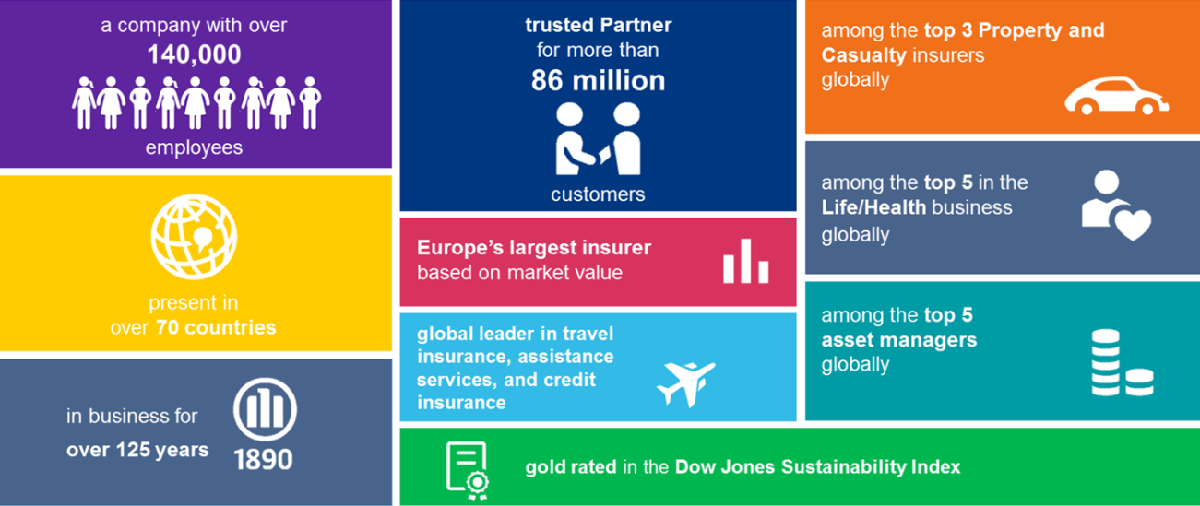
Allianz – at a glance

Slide 5
02
Key learnings

Slide 6

Learnings from Allianz
Basics of Insurance
Technical Training in WEB development technologies
Different software testing process
Attended Corporate induction session
Attended Security Arena session
Attended PM practice session
Attended Business System Analyst Session
Attended ACDM session

Slide 7

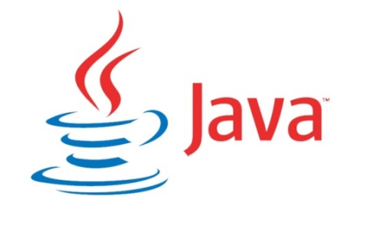

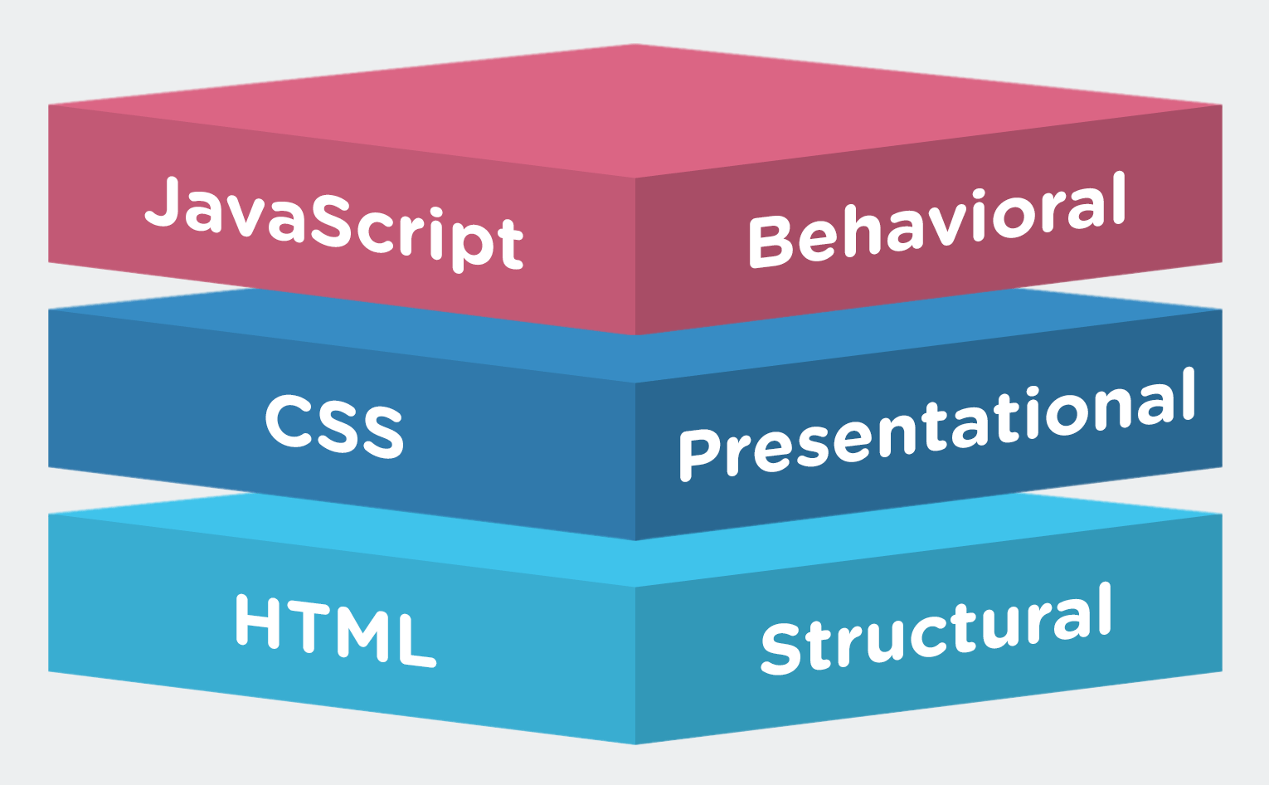
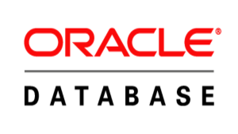


Web Development training - Technologies

Slide 8

Testing Training
Unit Testing
Integration Testing
Functional Testing
System Testing
User Acceptance Testing
Regression Testing
Performance Testing
Black box Testing
White box Testing

Slide 9
03
WEB development - Project

Slide 10
Project flow–Online air ticket booking system
Admin Module
Login
Admin Home Page
Manage User & flights
Logout
User Module
Login
Registration
User Home Page
Booking
Logout

Slide 11
04
Application and tools

Slide 12



Applications | Tools | Server

Slide 13
05
Project - Screenshots

Slide 14
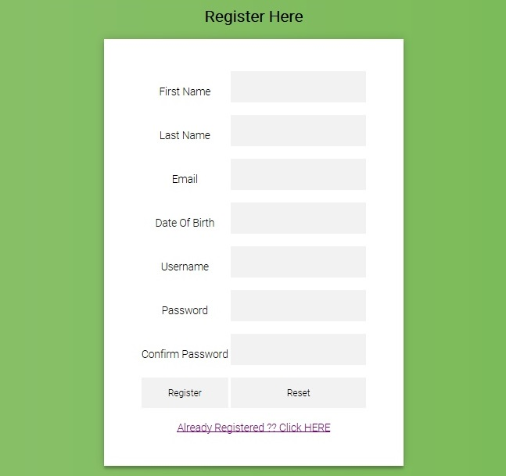
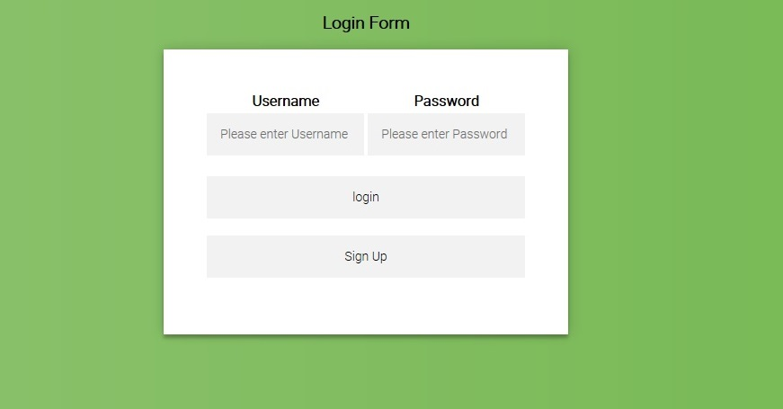
Project Screenshot–Online air ticket booking system

Slide 15
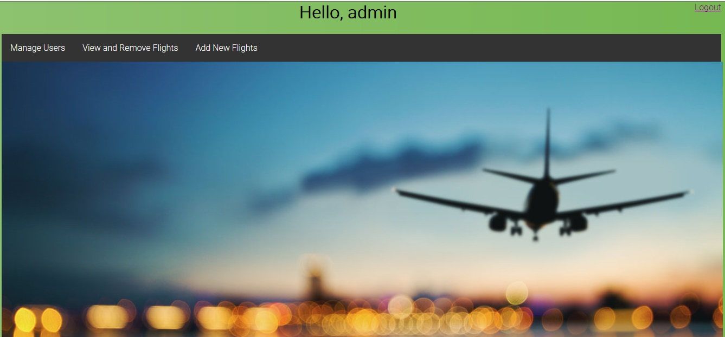

Project Screenshot–Online air ticket booking system

Slide 16
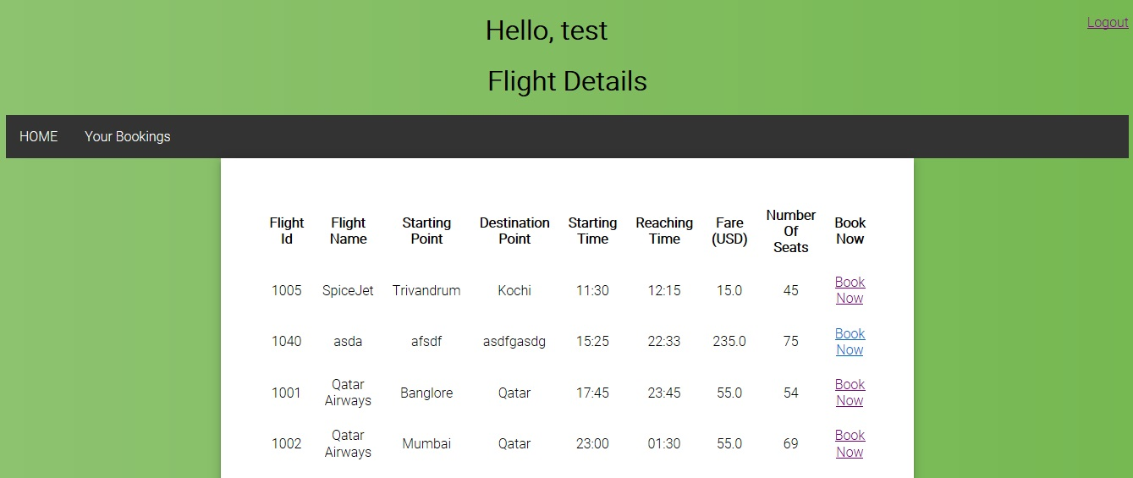
Project Screenshot–Online air ticket booking system

Slide 17
06
Claims

Slide 18
Policy
Policy
Commercial
Retail
A policy is a contract between the insurer and the insured in which the insurer promises to cover the insured for specific types of losses

Slide 19
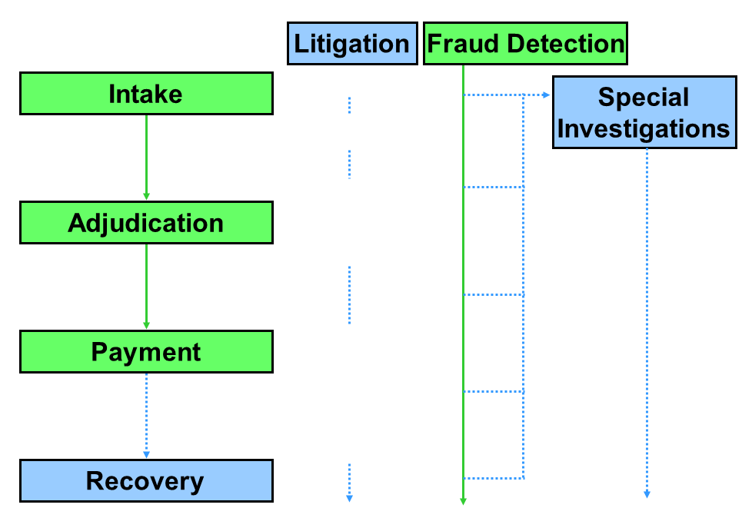
Claims – Business perspective
Discovery/ Investigation
Loss Assessment
Fundamental
Specialized
Subrogation
Salvage
Notes:
Litigation - the process of taking legal action(Lawsuit) - several activities which involve the resolution of disputes
the term "claims litigation" is generally used to refer to disputes that arise between an insurance company and its insured, or between an insurance company and someone who was injured by an insured
Negotiation
Mediation
Actual litigation
the carrier may also attempt to recover funds paid to the claimant by obtaining money from a third party's carrier if the third party was at fault (which is known as "subrogation")
by taking possession of a significantly damaged property and selling all or parts of it to a third party (which is known as "salvage").

Slide 20
Claims – MAIN APPLICATION SYTEMS
ClaimCenter
Contact Manager
Guidewire App
Coronet
IIB
PUMA
Mainframe App
FileNet App
MECS/VSS
VB App

Slide 21
07
Claim center

Slide 22
Guidewire – Claim center
2013 - Purchased the ClaimCenter application from Guidewire
CC7 – Genesis : New Claims Handling System that went live in 2013
Only broker notified motor Claims are handled
2013 – 2016 : FNOL Only – Rest handled by Coronet
2016 – Genesis end to end (GE2E)– End to End Claim handling in ClaimCenter
All new broker motor claims notified are handled through to settlement on ClaimCenter
Payments are still fulfilled in Coronet
2017 - Upgraded to CC9

Slide 23
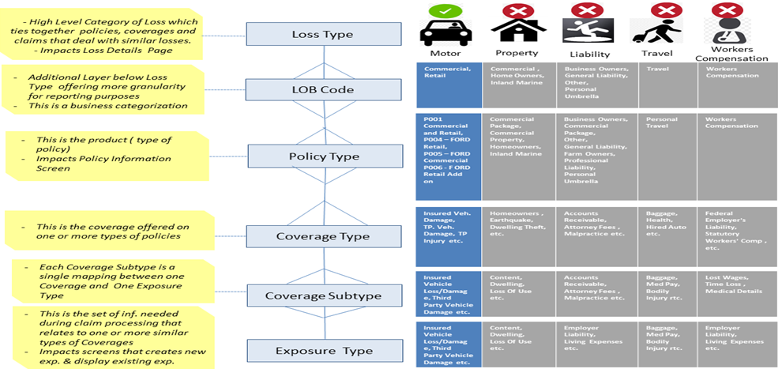
LINE OF Business in Claim center

Slide 24
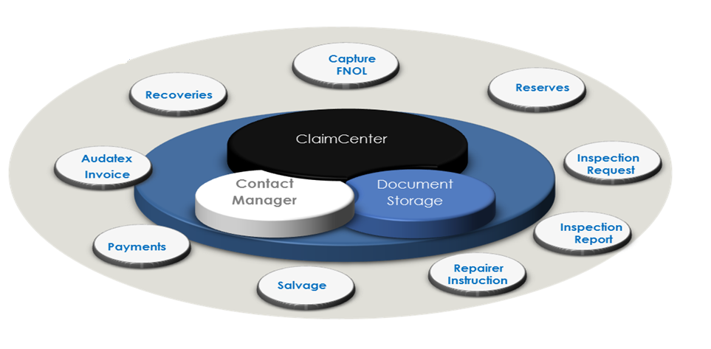
MAJOR Functionality

Slide 25
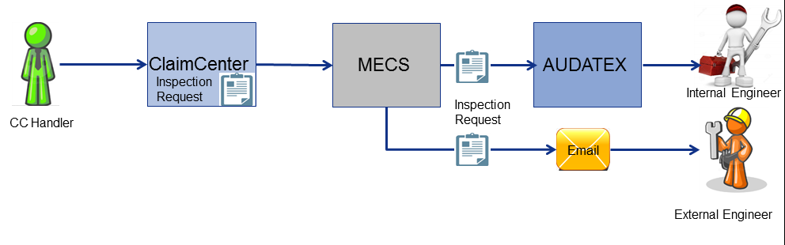
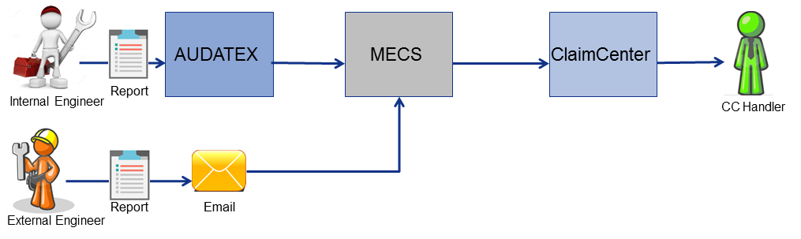
Inspection
Inspection Request
Inspection Report
Notes:
AUDATEX is a third party application which allows Internal Engineers and Approved Repairers to communicate and is also used for automating payment processing for the repairers.
MECS (Motor Engineers Control System ) is a Allianz owned system used for co-ordinating Engineer work flow.

Slide 26
payment
ClaimCenter
Coronet
BACS (Banking Automated Clearance Services)
Daily BACS– Electronic Payment – 3 days SLA
rollup BACS– Weekly/Month end: Whichever comes first – Bulk Amount- Frequent Payees
Cheques
Internal
(for audit purpose – payment will not be processed)
CHAPS – Cashiers pays
(same day payment – costly)
Daily BACS
Weekly BACS
Cheque – non roll up
Non cheque
To Bank Payments
Clearing House Automated Payment System -CHAPS

Slide 27
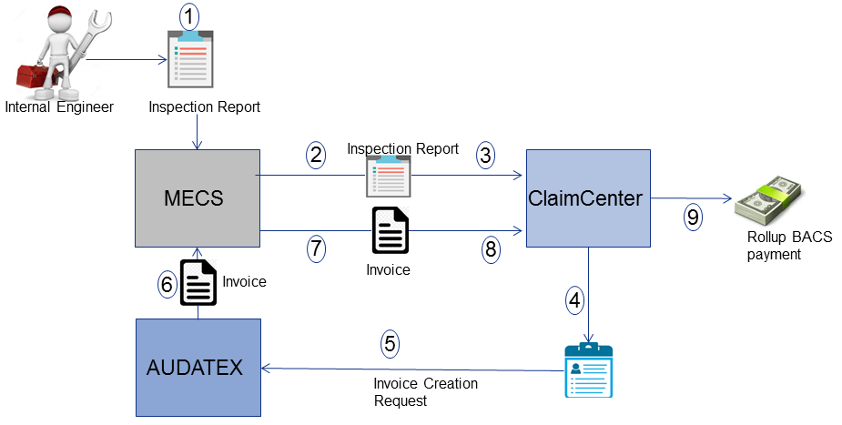
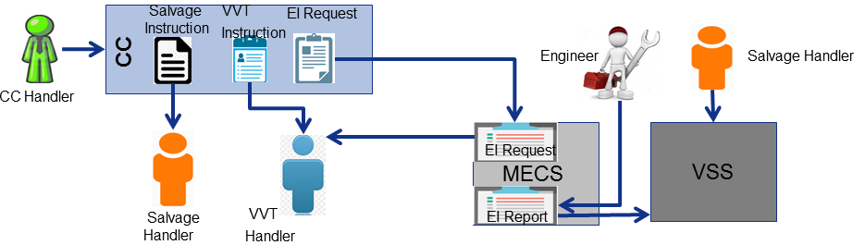
Salvage & Invoice processing
Audatex Invoice processing
Salvage
VVT – Vehicle Valuation Team
VSS – Vehicle Salvage System (Owned by Allianz)

Slide 28
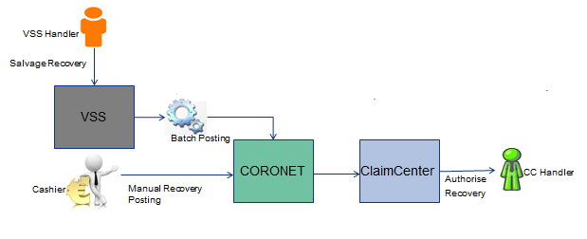
Recoveries
Recovery is term used for collection of receivables to Allianz .
Recoveries can be posted manually or by batch.

Slide 29
Guidewire-Gosu
Gosu is Guidewire's programming language
Has elements of both procedural and object-oriented programming languages
Similar to JavaScript and Java
Gosu specifies runtime business logic that:
Executes fundamental application behavior
Manages complex business processes
Specifies dynamic client-side behavior

Slide 30
08
Participation

Slide 31

Participation
Team Engagement
Digithon 2.0
Sparsh 2017

Slide 32
Thanks to
Sunil Raveendran
Viji Sam
Varun Raj
Vinu Viswanath
Hareesh Sreenivasan
Sony Mathew
Gayathri Kumar
Atul Sasidharan
And the remaining PT’s who joined Allianz with me.

Slide 33



